Slide 1
Hybrid Algorithms

Slide 2
The Rise of Heterogenous Computing

Slide 3

Processor on a Board

Slide 4
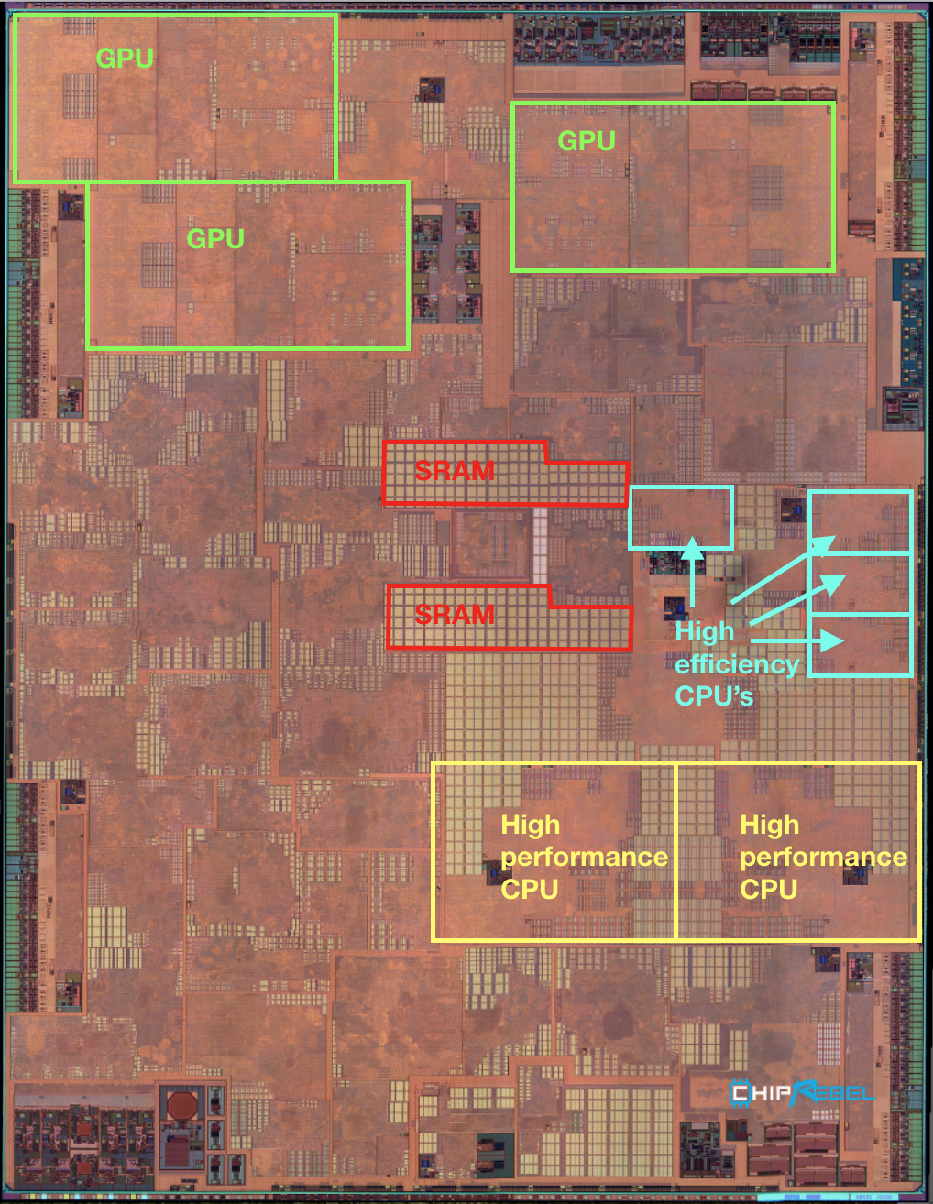
Heterogenous Processors
Notes:
Why do we want to have different kinds of processors on a phone?
What is your typical usage? What apps do you have running on your phone?
Can someone share the apps they currently have running (in the background)?
Introduce the notion of a workload.
A bunch of apps with different characteristics and different demands for resources.

Slide 5
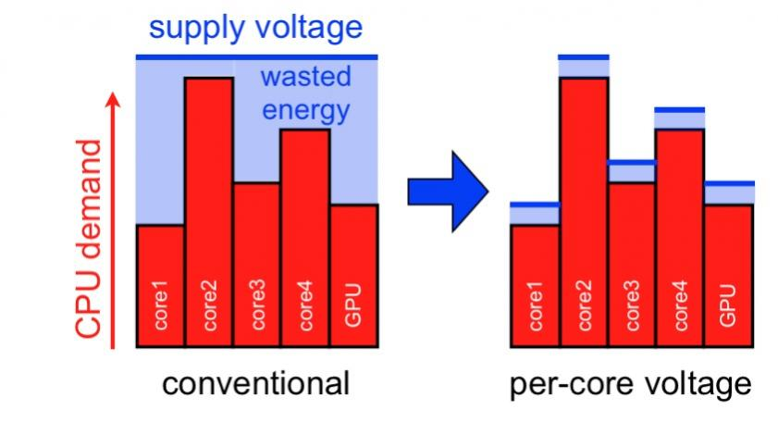
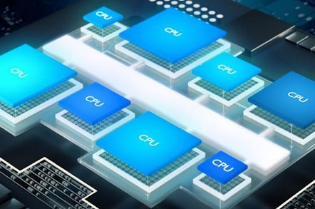
“Soft” Heterogeneity
Fat and Thin Cores
DVFS
image: SemiWiki

Slide 6
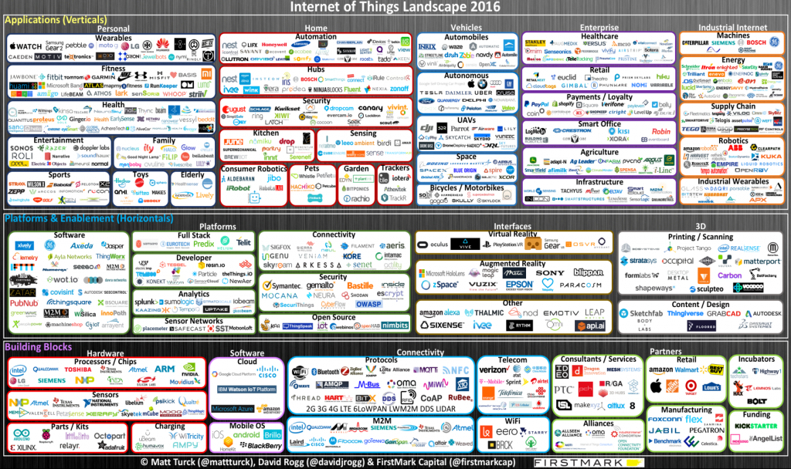
Heterogeneity on the Edge

Slide 7

von-Neuman is Evolving
Computer

Slide 8
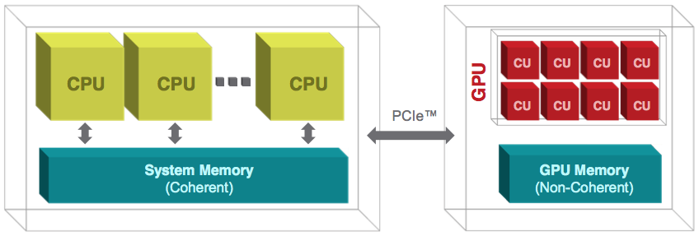
CPU + GPU Heterogeneity

Slide 9
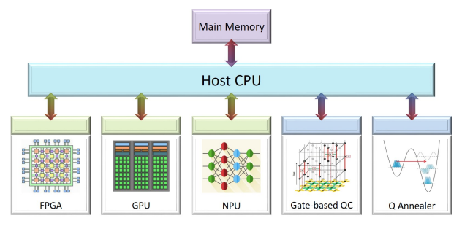
Heterogeneous System Architecture
Notes:
Image source: bertels et al.

Slide 10
Parallel Algorithms
spawn
sync
Notes:
Rectangles represent tasks/strands

Slide 11
Hybrid Algorithms
Within the offloaded task, work is done in parallel following the SIMT model
spawn
Offloaded task executes in parallel to CPU tasks
sync
task offloaded to GPU
Notes:
- just like launching a new thread, offloading a task to an accelerator has an overhead.
sub-tasks within the offloaded task will execute in parallel, but ignoring that in this module
will just consider the offloaded task as an indivisible unit (i.e., strand)
GPU task executes in parallel with CPU
Standard dependence rules apply for the computation DAG.

Slide 12
Heterogeneous Parallel Algorithms
many complex collaborative design patterns are possible
Notes:
Mention hybrid design patterns

Slide 13
Heterogenous Programming Models
Accelerators have their own programming model
GPUs employ a parallel programming model known as
SIMT: Single instruction multiple data
We can analyze the complexity of hybrid algorithms without having to delve into the programming models of accelerators
We will make a simple extension to the Dynamic Multithreading Programming model introduced in CLRS, to express algorithmic heterogeneity
Notes:
- accelerators have their own programming models
- the model between CPU and accelerator can be thought of the message-passing model
- diagram of message-passing with illustrations of CPU and accelerator
- current technology allows us to employ the dynamic multithreading or shared memory model
- illustration of shared memory model with CPU and accelerator

Slide 14
Dynamic Multithreading Programming Model
DMP follows the shared-memory parallel programming model
Abstracts out the details of the underlying hardware
Assumes threads are scheduled to provide perfect load-balance and utilization of parallel processors
Notes:
See Chapter 27 of CLRS for a more detailed treatment

Slide 15
DMP Notation: Spawn and Sync
fib(n)
1 if n ⩽ 1
2 return n
3 else x = fib(n–1)
y = fib(n–2)
5 return x + y
par-fib(n)
1 if n ⩽ 1
2 return n
3 else x = spawn par-fib(n–1)
y = par-fib(n–2)
sync
6 return x + y

Slide 16
Expressing Heterogeneity with task
We can extend DMP for heterogeneity by only adding a single keyword
task is short for task offloading
task spawns a new thread to be executed on the accelerator
task keyword is standard in OpenMP
par-fib(n)
1 if n ⩽ 1
2 return n
3 else x = task par-fib(n–1
y = par-fib(n–2)
return x + y

Slide 17
Divide-and-Conquer
recurse(param)
1 if end_condition(param) then
2 return base_case(param)
3 {param}_{j} ⃪ divide(param)
4 for j = 1 to |{param_j}| do
5 S_{j} ⃪ recurse(param_{j})
6 S ⃪ combine({S_{j}}, param)
7 return S
T(n) = aT(n/b) + f(n), T(1) = Θ(1)
Notes:
pseudocode notation taken from CLRS;
In-class go through derivation of runtime asymptotic analysis

Slide 18
Merge Sort
mergesort(array, start, end)
1 if start < end then
2 div = (start + end)/2
3 mergesort(array, start, div)
4 mergesort(array, div + 1, end)
5 merge(array, start, div, end)
T(n) = 2T(n/2) + f(n), T(1) = Θ(1)
Notes:
In-class go through derivation of runtime asymptotic analysis

Slide 19
Parallel Merge Sort
mergesort(array, start, end)
1 if start < end then
2 div = (start + end)/2
3 spawn mergesort(array, start, div)
4 mergesort(array, div + 1, end)
5 sync
6 merge(array, start, div, end)
T(n) = max(T(n/2),T(n/2)) + f(n), T(1) = Θ(1)
Notes:
In class, go through derivation of runtime asymptotic analysis

Slide 20
Merge Sort with Acceleration
mergesort(array, start, end)
1 if start < end then
2 div = (start + end)/2
3 task mergesort(array, start, div) sync
4 mergesort(array, div + 1, end)
6 merge(array, start, div, end)
T(n) = T(n/2) + T^{A}(n/2) + f(n), T(1) = Θ(1)
Notes:
In-class go through derivation of runtime asymptotic analysis

Slide 21
Parallel Merge Sort with Acceleration
mergesort(array, start, end)
1 if start < end then
2 div = (start + end)/2
3 task mergesort(array, start, div)
4 spawn mergesort(array, div + 1, end)
5 sync
6 merge(array, start, div, end)
T(n) = max(T(n/2), T^{A}(n/2)) + f(n); T(1) = Θ(1)
Notes:
In class go through derivation of runtime asymptotic analysis

Slide 22
Practical Considerations
Identifying task for offloading
Scheduling
Data movement

